Slide 1
Agenda 10/11
Project 2: Augmented Projections
DUE 10/21: Electronic Art & Intermedia Showcase
Homework
Arrays Review
PoseNet: A library for using the body for interactions

Slide 2
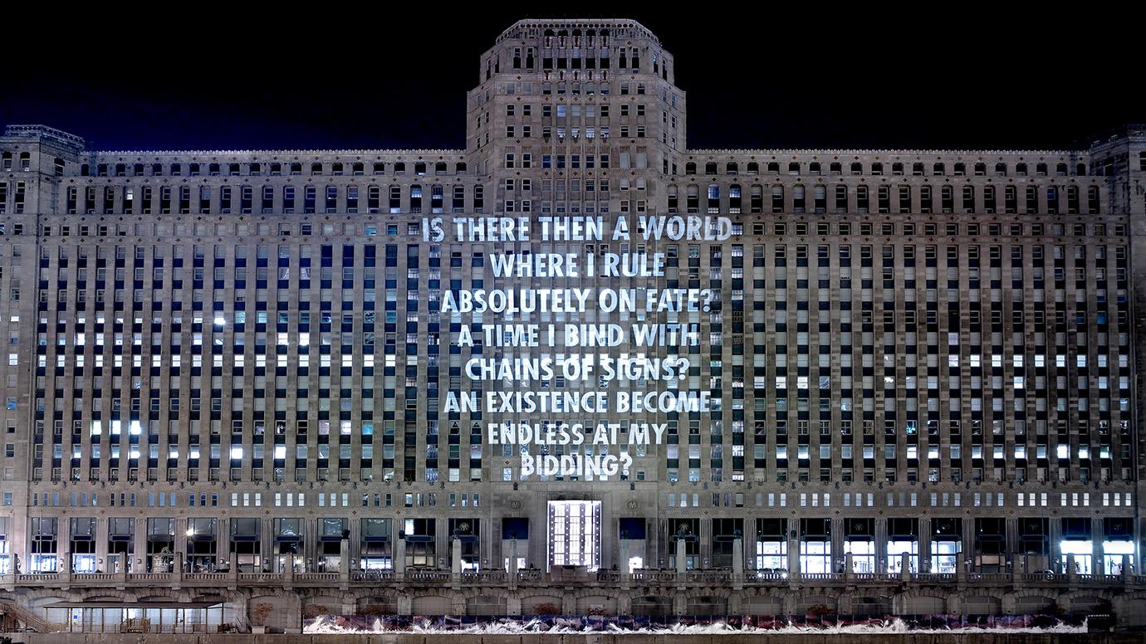
Inspiration
Jenny Holzer: https://www.youtube.com/watch?v=QeOOFKzQxS0

Slide 3
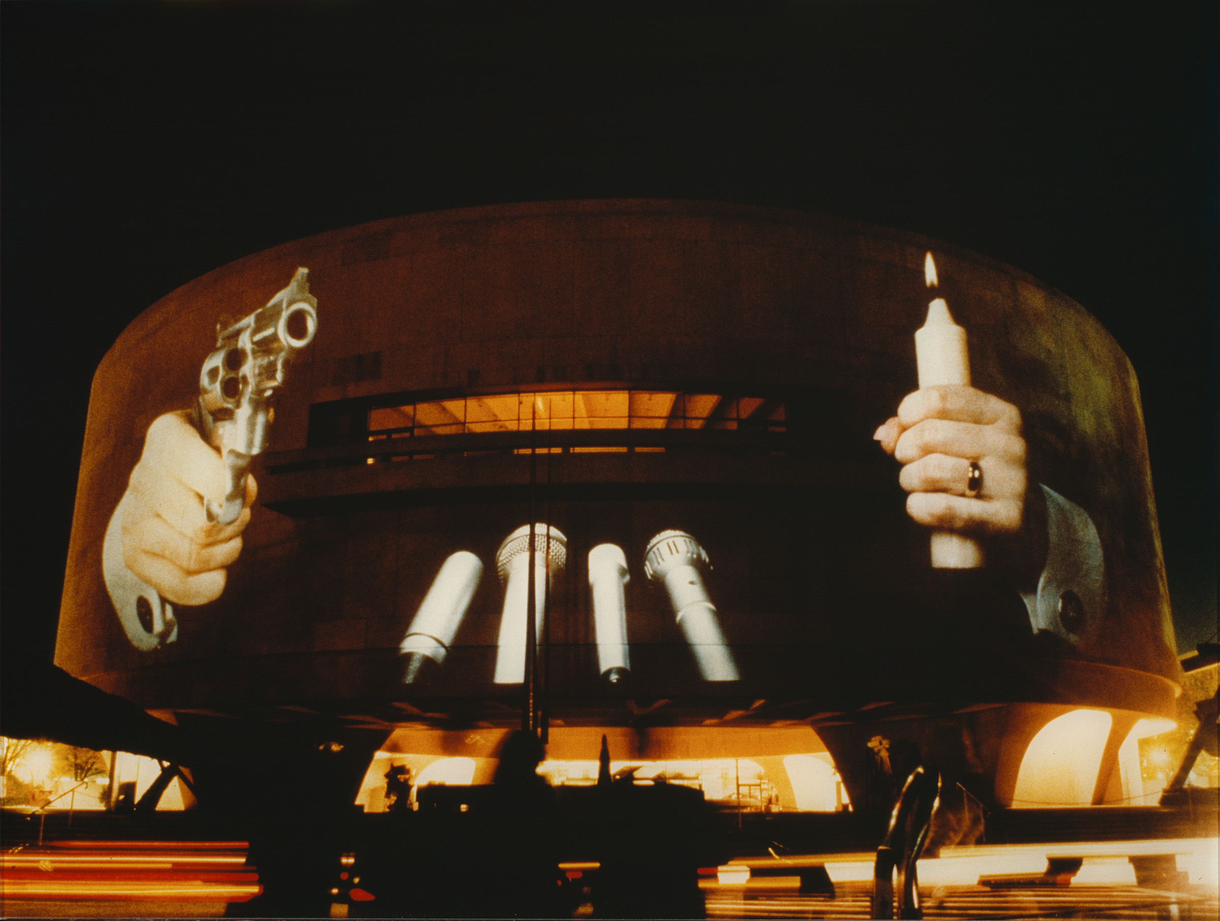
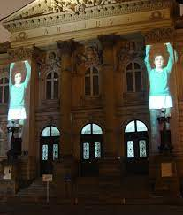
Inspiration
Krzysztof Wodiczko: https://www.youtube.com/watch?v=bxyWkfIuSJo

Slide 4
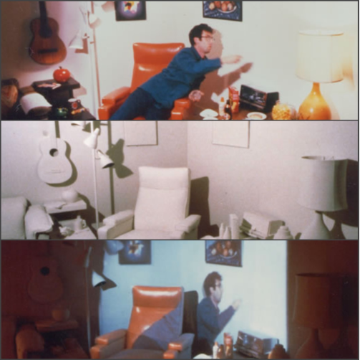
Inspiration
Michael Naimark – Displacements(1980)
https://www.youtube.com/watch?v=-15vr7OcVYM

Slide 5
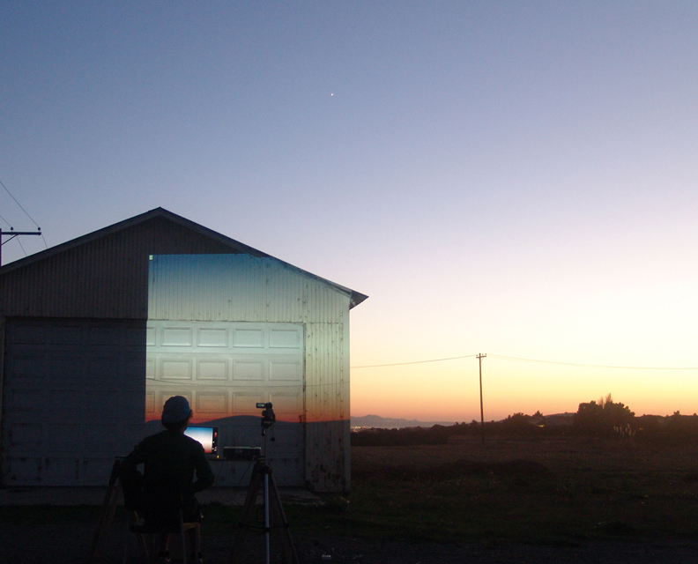
Inspiration
Sunset Solitaire by Joe McKay : https://www.youtube.com/watch?v=DchBgy8yCd0

Slide 6
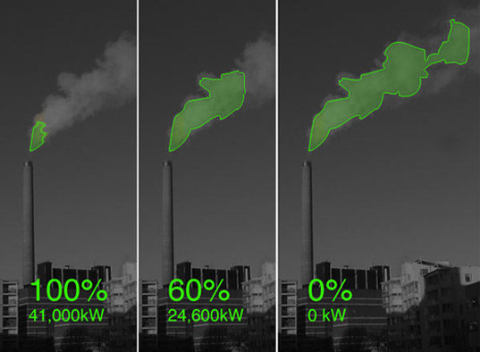
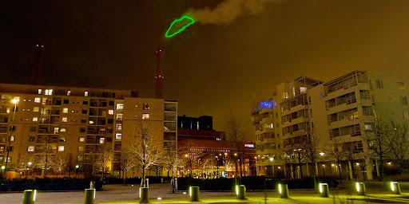
Inspiration
Nuage Vert by HeHe

Slide 7
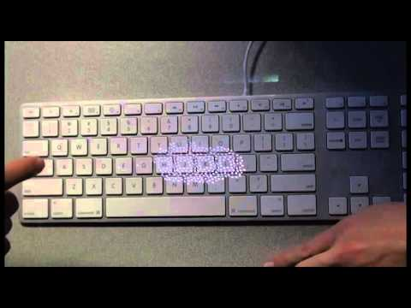
Inspiration
Keyfleas by Miles Hiroo Peyton : https://www.youtube.com/watch?v=-VvTcBDFhtY

Slide 8
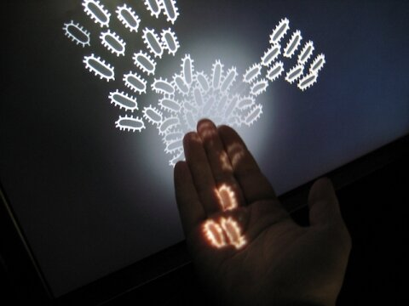
Inspiration
Delicate Boundaries by Chris Surge: https://www.youtube.com/watch?v=QJ-uUnsFdxg

Slide 9
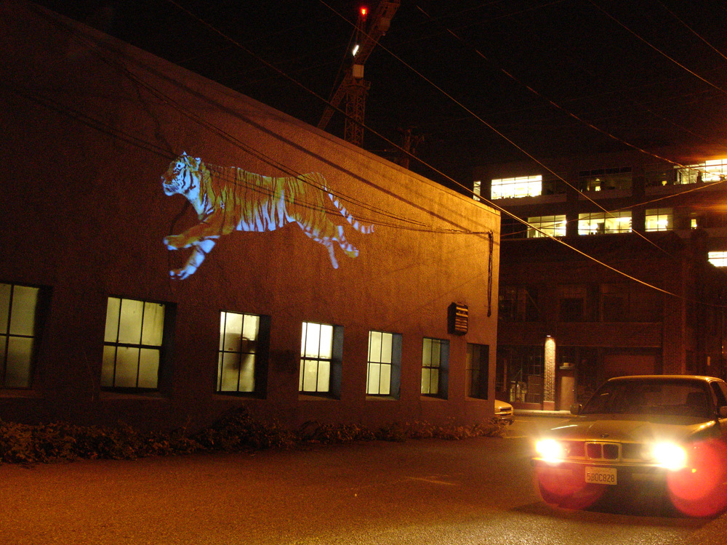
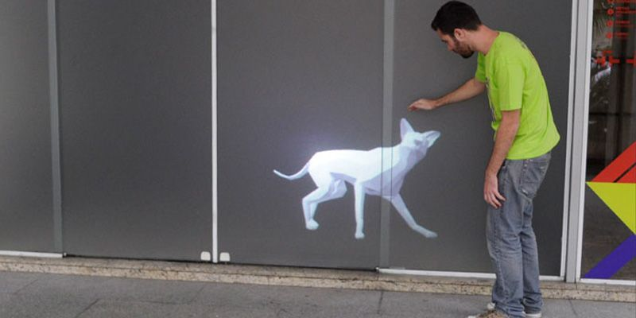
Inspiration
Karolina Sobecka : https://www.youtube.com/watch?v=lpju7FtSJ7U

Slide 10
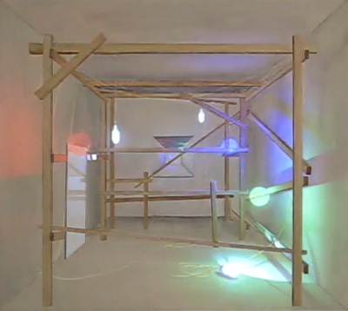
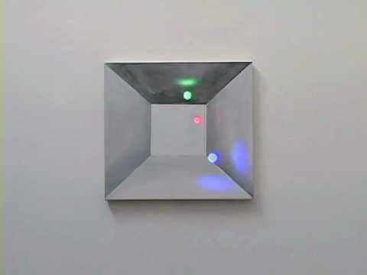
Inspiration
Michael Guidetti - Bounce Room: https://www.youtube.com/watch?v=288Z1m-bsIc

Slide 11
Homework DUE 10/13
Bring Proposals for Project 2 to class
Sketches, Drawings, Images
Example p5js code
Anything else that indicates that you have thought through this project
You will be asked to present this to class
We will also walk outside to look at which surfaces you want to project onto

Slide 12
Site Visit : Summer Courtyard Circle
What is a Site Visit? – A tour of the location where you want to do your illuminated projection intervention
Why? This project is requiring you to create something site-specific i.e. it is custom made for a specific location. We must understand the various aspects on the space
How?
Walk around, Take Notes, Take Pictures
Examine the Architecture, surfaces texture, people, objects, nature. All of these constitute as space.
Sit down for 5 mins and see how all the above are interacting with each other

Slide 13
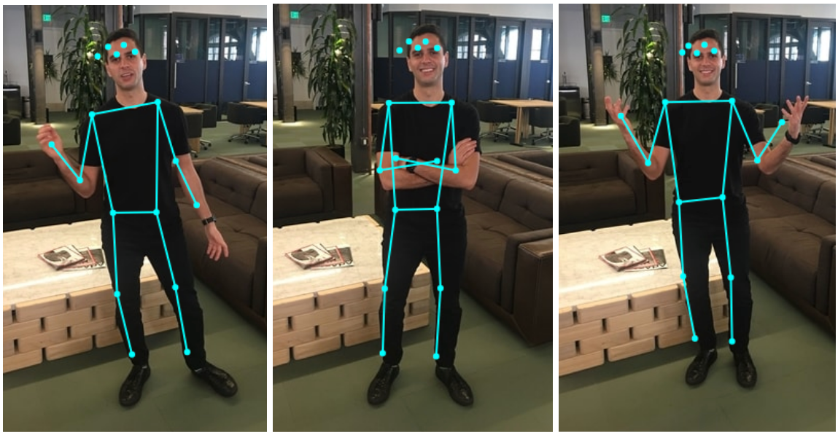
PoseNet (ml5 js)
A Javascript library that can be used to estimate body poses in real time video. Using this library, we can create interactive new media projects that respond to the body. Posnet is developed using Machine Learning wherein algorithms are trained with body posture dataset to “learn” to “see” the body.

Slide 14
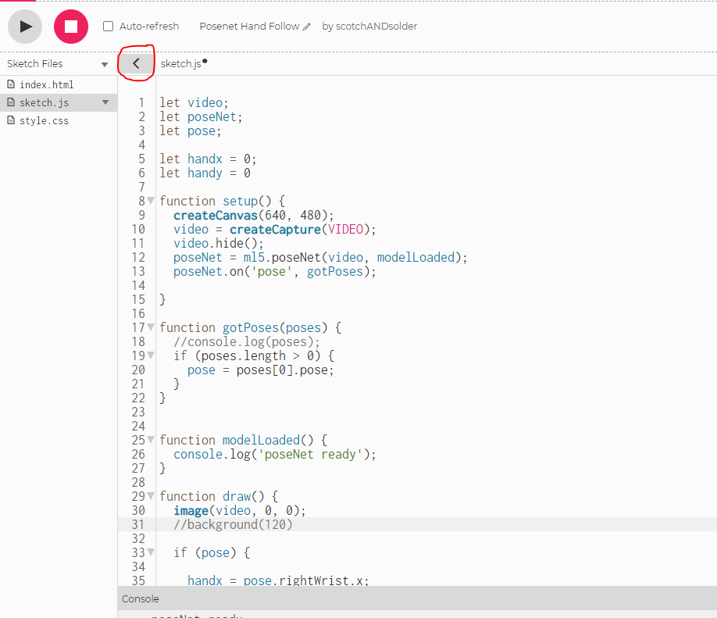
PoseNet (ml5 js) – How to add the library?
Click on the caret to see all the files in your sketch

Slide 15
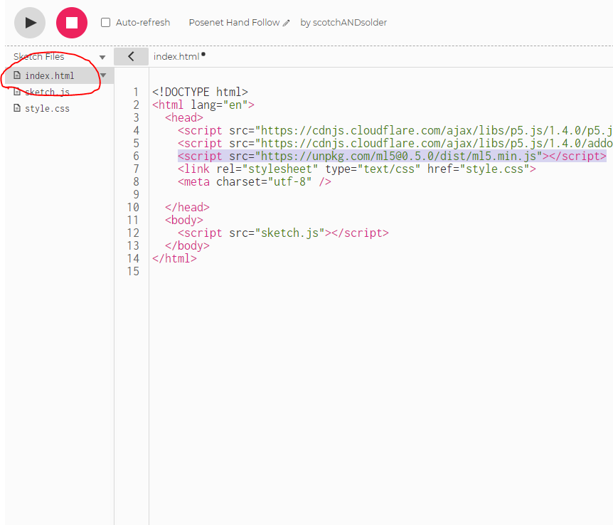
PoseNet (ml5 js) – How to add the library?
Open index.html and add the following line:
<script src="https://unpkg.com/ml5@0.5.0/dist/ml5.min.js"></script>
Open : https://editor.p5js.org/scotchANDsolder/sketches/5HV1aVmcM to start with a basic sketch

Slide 16
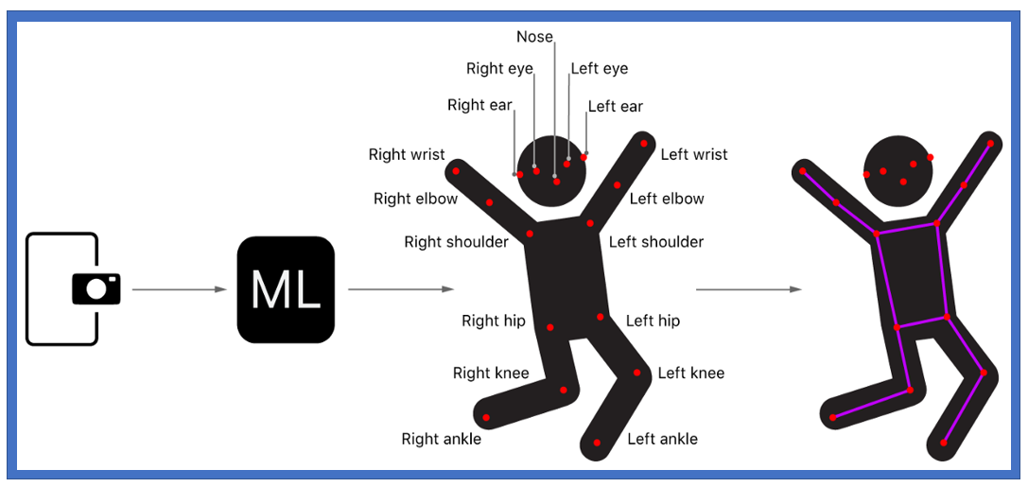
PoseNet (ml5 js) – Available body points
Exact Names of points : https://www.tensorflow.org/lite/examples/pose_estimation/overview

